Slide 1
Modernizing Risk Management in the Banking Sector Using Advanced Data Analytics
Project Overview and Key Insights
Prepared by: Jean C. Quinones

Slide 2
Introduction
Dataset Overview:
- Contains details about loan applicants including income, credit history, and loan amount.
Problem and Motivation:
- Analyze patterns in credit risk to improve decision-making for financial institutions.
- Mitigate risks associated with defaults while optimizing loan approvals.

Slide 3
Project Objective
Objective:
- To identify key factors affecting credit risk.
- Provide actionable recommendations to reduce risk and improve loan strategies.

Slide 4
Data Exploration
Key Insights:
- The dataset includes demographic and financial data.
- Significant variations observed in income levels and credit history.
Visual representations highlight trends in default rates based on income brackets.

Slide 5
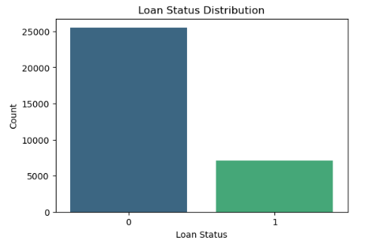
- Most applicants fall under the 'non-default' category.
- Highlights the dataset's imbalance, which affects the model's learning.
Loan Status Distribution

Slide 6
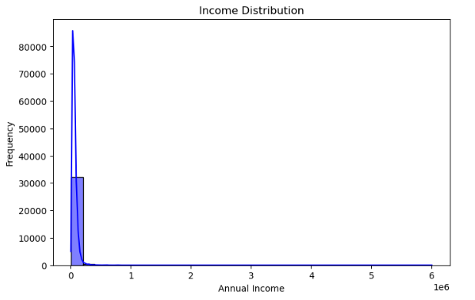
- The majority of applicants have lower annual incomes.
- Indicates the need to understand risk for low-income borrowers.
Income Distribution

Slide 7
Findings
- Low-income groups are at a higher risk of default.
- Applicants with poor credit history demonstrate significantly higher risk.
The analysis revealed a strong correlation between income levels and credit risk.

Slide 8
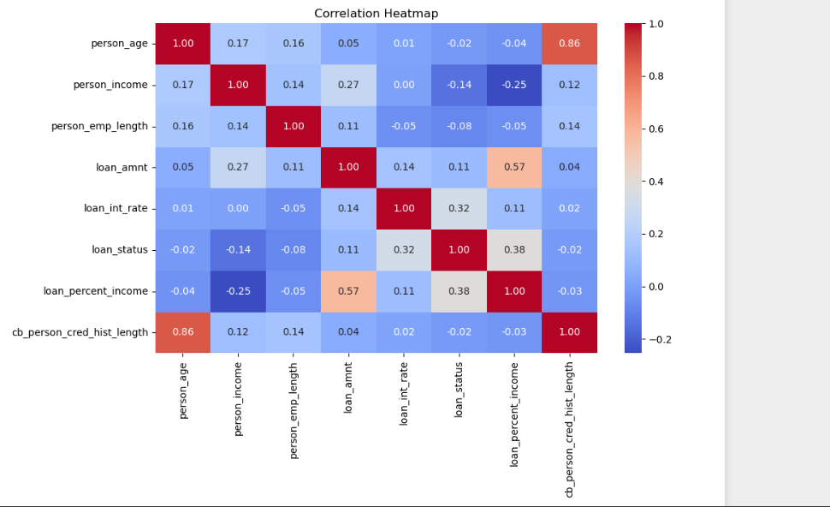
- Shows default probabilities at varying loan interest rates.
- Demonstrates how higher rates increase the likelihood of defaults.
Monte Carlo Simulation

Slide 9
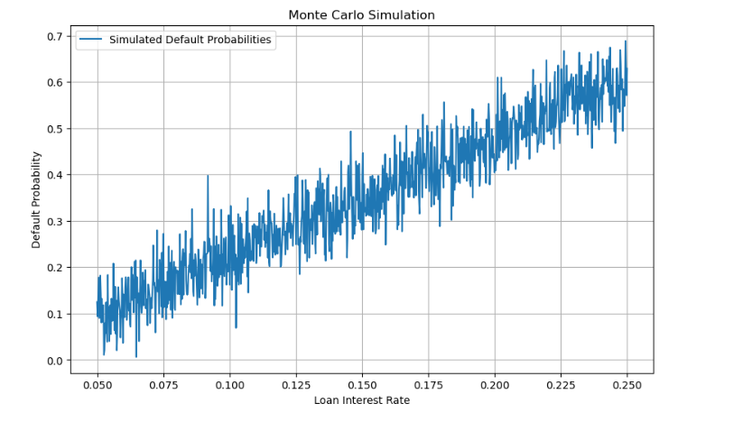
- Visualizes the model's performance.
- Highlights true positives, true negatives, false positives, and false negatives.
Confusion Matrix

Slide 10
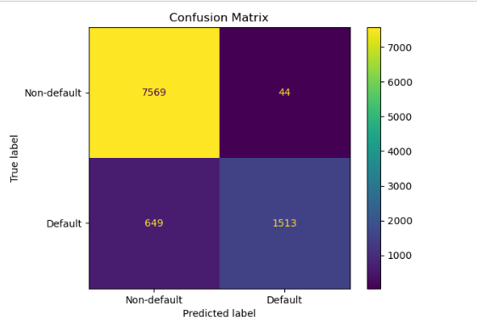
- Reveals relationships among variables.
- Key findings: Income and credit history are crucial predictors of default.
Correlation Heatmap

Slide 11
Recommendations
To minimize risk, the following are recommended:
- Prioritize applicants with positive credit histories.
- Develop financial literacy programs for at-risk groups.
- Implement robust eligibility criteria based on identified risk factors.

Slide 12
MOST CHALLENGING ASPECT
What aspect of data analytics and data science did you find most challenging in completing your term project?
The most challenging aspect of the project was managing data imbalance between 'default' and 'non-default' loans, which required careful resampling or metric adjustments to ensure fair model evaluation. Additionally, feature selection and identifying key predictors like income and credit history were critical but time-intensive. Balancing interpretability and performance for stakeholders and creating clear visualizations also posed challenges. These steps required thoughtful approaches to make the insights actionable and understandable.

Slide 13
ASPECT OF MOST LEARNING.
What aspect of data analytics and data science did you learn the most about in completing your term project?
I learned the most about handling imbalanced datasets and the importance of feature selection. Managing class imbalance taught me techniques like resampling and using appropriate evaluation metrics to avoid biased models. Additionally, identifying key predictors, such as income and credit history, deepened my understanding of how data preprocessing and selection impact model performance and interpretability. These skills are critical for building effective, real-world solutions in data science.

Slide 14
FUTURE WORK.
What would be your top priority for future work if you were to continue this project as an independent study or research project?
My top priority for future work would be to collect additional data to address the class imbalance and improve model accuracy. With more balanced and diverse data, the model could better capture patterns and make more reliable predictions. This would also help validate the findings and ensure they generalize well to new data.

Slide 15
Conclusion
Summary:
- The project identifies critical factors influencing credit risk.
- Emphasizes the need for improved policies targeting low-income applicants.
Future Work:
- Incorporate additional variables such as employment stability for further insights.

